Slide 1
Pulmonary Tuberculosis
Pulmonary tuberculosis is usually divided into primary and secondary forms.
Primary tuberculosis is the result of the first infection with Mycobacterium tuberculosis and usually occurs in childhood.
Secondary tuberculosis, the usual form in
adults, is believed to be re-infection.

Slide 2
Primary tuberculosis
In primary tuberculosis, an area of consolidation, develops in the periphery of the lung – usually in the mid or upper zones. Usually, the pulmonary opacity is small, but it may occasionally involve most of the lobe.

Slide 3
Sometimes the pulmonary consolidation is so
Small that it is invisible. The consolidation is often accompanied by visibly enlarged hilar or mediastinum lymph nodes. This combination of pulmonary consolidation and lymphadenopathy is known as the primary complex.

Slide 4
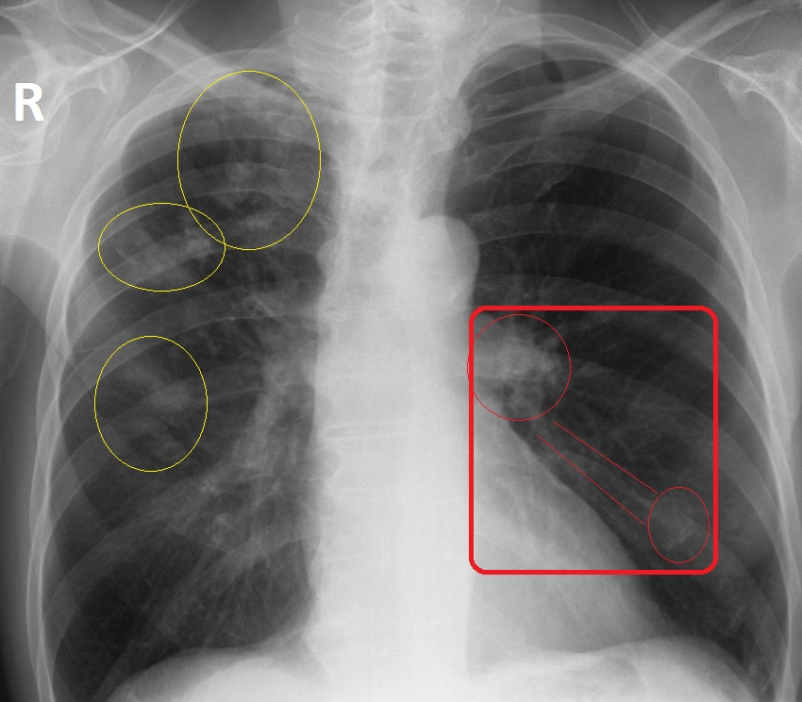
Primary complex Tb

Slide 5
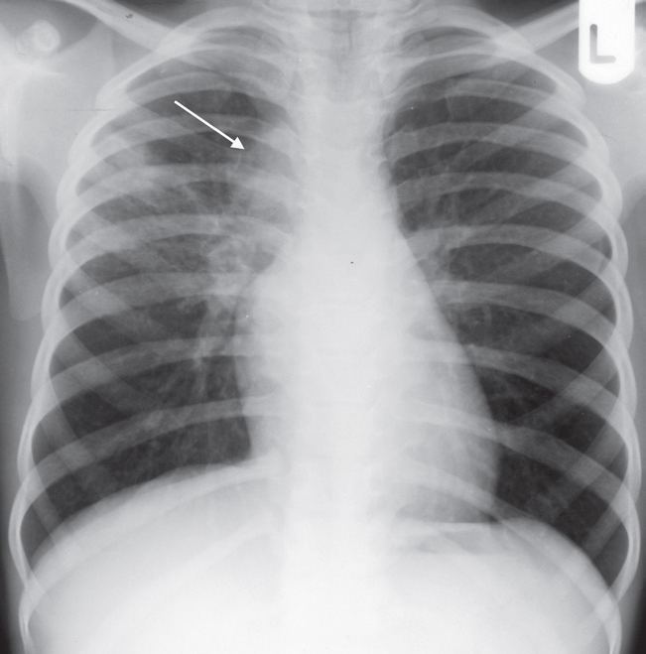
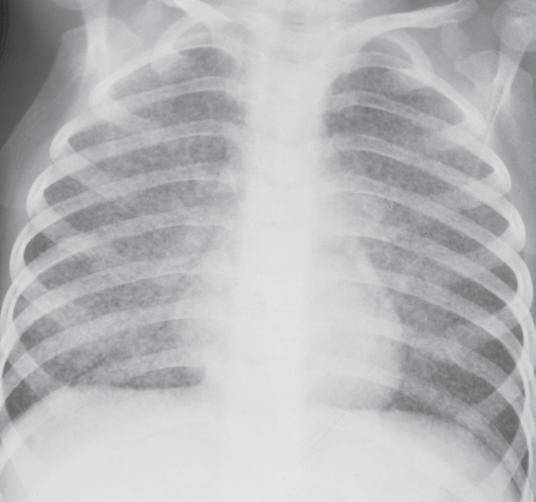
Tuberculosis. (a) The primary complex. This 7-year-old child shows ill-defined consolidation in the right lung together withenlargement of the draining lymph nodes (arrow). (b) Miliarytuberculosis. The innumerable small nodular opacities uniformly distributed throughout the lungs in this young child are typical of miliary tuberculosis

Slide 6
The clinical features of the primary complex vary.
The majority of patients have few, if any, symptoms; the remainder have fever, cough and malaise/ night sweating
In most cases, whether treated or not, the primary complex heals and often calcifies. A calcified primary complex often remains visible throughout life.

Slide 7
Spread of primary tuberculosis infection may occur via two route
The bronchial tree, leading to tuberculosis bronchopneumonia. This appears radiologically as patchy or lobar consolidation; it often involves more than one lobe, may be bilateral and frequently cavitates.
2. The blood stream, resulting in miliary tuberculosis in which there are innumerable small nodules in the lungs, all much the same size and fairly evenly distributed.

Slide 8
A pleural effusion may be present. It is important to note that the chest film may be normal in the early stages of miliary tuberculosis.

Slide 9
Secondary Tuberculosis
Secondary tuberculosis usually presents with cough, haemoptysis, weight loss, night sweats or malaise. Occasionally, the disease is discovered on a routine chest film. Post primary tuberculosis is usually confined to the apical and posterior segments of the upper lobes and the apical segments of the lower lobes, though may present as a lower or middle lobe bronchopneumonia. The initial lesions are multiple small areas of consolidation

Slide 10
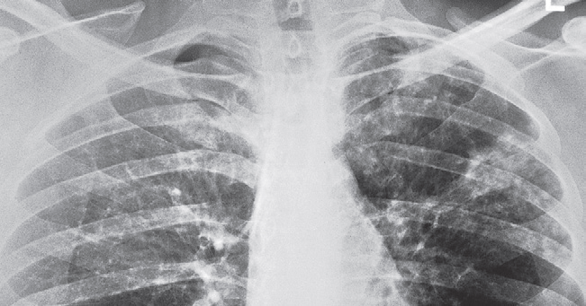
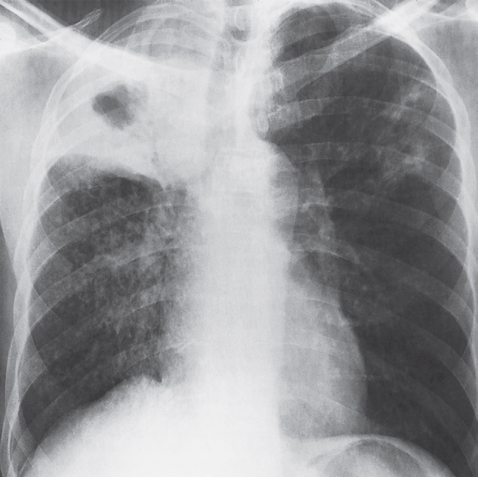
Postprimary tuberculosis. (a) There are ill-defined consolidations scattered in both upper lobes; their size and distribution should suggest the diagnosis of postprimary tuberculosis. (b) The right upper lobe is consolidated and contains a large central cavity. Patchy consolidation from tuberculous bronchopneumonia is seen in the right mid and lower zones and in the left upper zone

Slide 11
Pleural effusions are frequent and may be the only radiographic abnormality.
If the infection progresses, any areas of consolidation may enlarge and frequently undergo cavitations. Cavities are seen as rounded air-spaces (translucencies) completely surrounded by pulmonary Opacification.

Slide 12
The infection may undergo partial or complete healing at any stage. Healing occurs by fibrosis, often with calcification

Slide 13
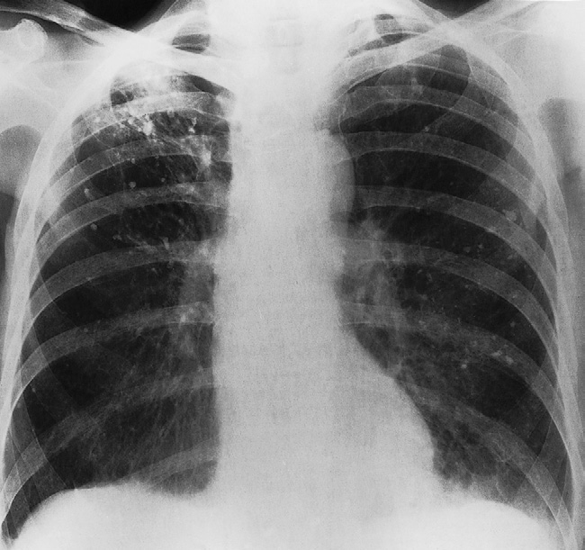
Old calcified tuberculous disease. There are numerous foci of calcification in both lungs

Slide 14
Thank you

